Slide 1
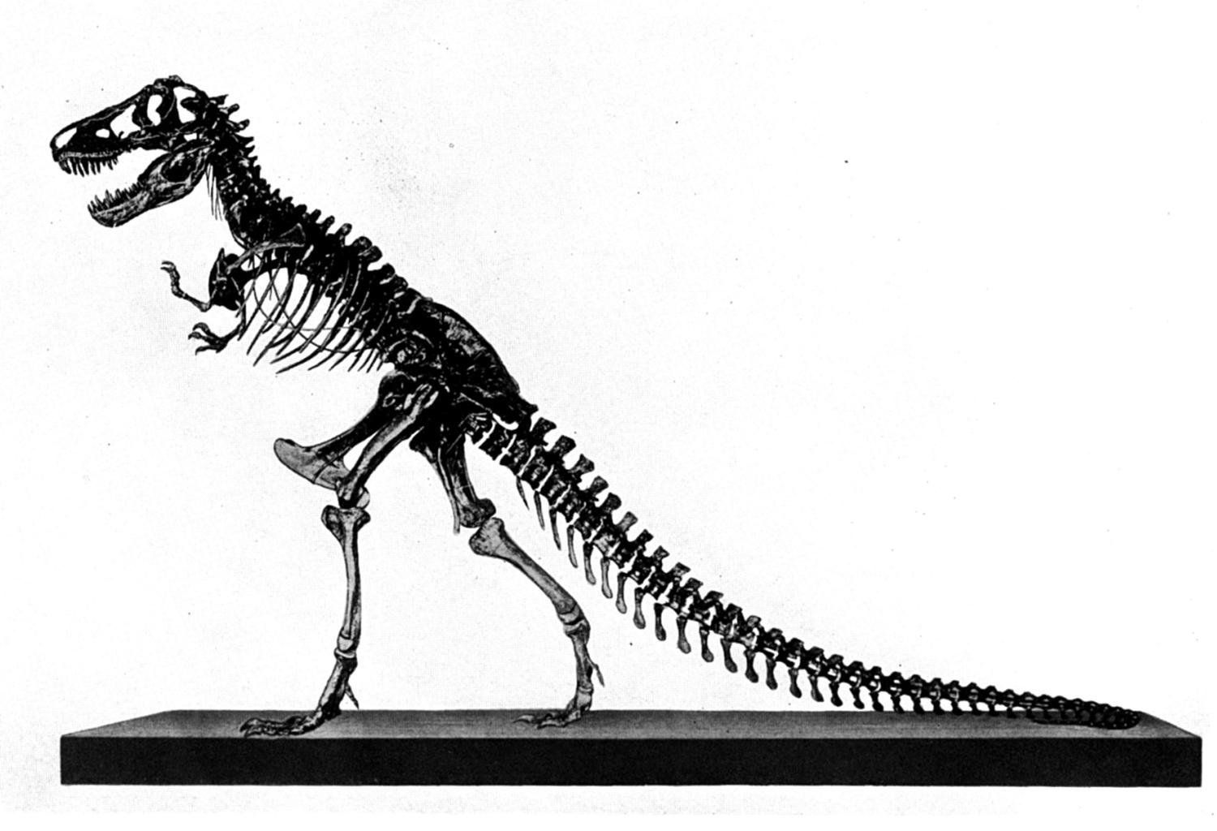
Behemoth &
Leviathan
Job 40:15-41:34
(context)
Part 2a

Slide 2
Review:
Why preach this material:
  Because it is scriptural (2 Tim. 3:16)
  Because of the war waged against the scriptures by atheists
  Because the truth about dinosaurs is lost in the millions of years interpretation
  Because of the abundance of misinformation published

Slide 3
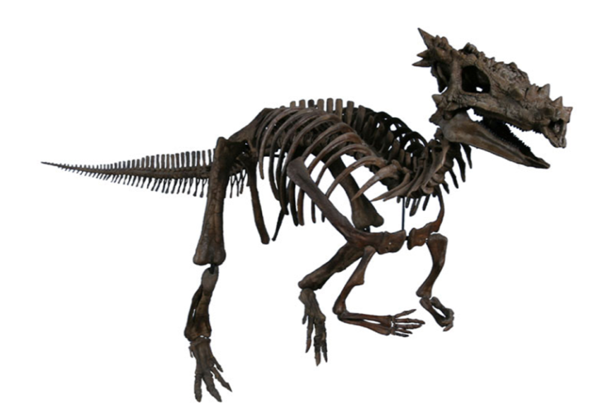
Review:
Evidence that man and dinosaurs lived together
  Biblical and extra-biblical sources
  Discovery of “Dracorex” (dragon king)
  Literary references to “dragons”
  Hebrew, “Tanniyn” (land, sea,
  flying)
    Gen. 1:21; Ex. 7:9, 10, 12; Neh. 2:13;
    Ps. 74:13, 14, 91:13; 148:7; Is. 27:1;
    Ezek. 32:2; etc.)

Slide 4
Hebrew “TANNIYN”
Jeremiah 51:34, “Nebuchadrezzar the king of Babylon hath devoured me, he hath crushed me, he hath made me an empty vessel, he hath swallowed me up like a dragon <08577>, he hath filled his belly with my delicates, he hath cast me out” (KJV, monster, NKJV)

Slide 5
More Evidence
Behemoth and Leviathan
(Job 40:15-41:34)
  Descriptive of two very large imposing animals (40:19, 20; 41:33)!
    Unlike anything living today
  “O Lord, how manifold are Your works! In wisdom You have made them all. The earth is full of Your possessions” (Ps. 104:24)

Slide 6

Erasing The Significance Of This Sacred Text
Man has done two things to this text to stay true with evolutionary assumptions
  Make the text speak only of mythical creatures
And if that fails…
  Reduce and define the significance of these creatures into “contemporary” animals (hippopotamus, elephant, crocodile, etc.)
CONTEXT
TEXT

Slide 7
MANY CHRISTIANS HAVE BEEN
“EVOLUTIONIZED” BY THE MEDIA AND EDUCATION
Take secular thinking to the bible rather than build their way of thinking from the bible
Take a natural interpretation to the scriptures rather than seeing the supernatural God of the scriptures
Take worldly opinions to the bible rather than take the wisdom in the bible to the world

Slide 8
It Does Not Matter
If similarities can be found between “Leviathan” and “Lotan” (a monster found in Ugaritic mythology)
If Isaiah refers to a figurative Leviathan (Is. 27:1)
If Asaph refers to Pharaoh or some obstacle in Israel’s past as Leviathan (Ps. 74:13, 14)

Slide 9
Leviathan Was A REAL Creature!
Psalm 104:24-27,
24 O LORD, how manifold are Your works! In wisdom You have made them all. The earth is full of Your possessions—
25 This great and wide sea, In which are innumerable teeming things, Living things both small and great.
26 There the ships sail about; There is that Leviathan which You have made to play there.
27 These all wait for You, That You may give them their food in due season.

Slide 10
The Context
Behemoth & Leviathan

Slide 11
Job Held To His Righteousness (27:1-6)
Charged of wickedness by his “friends”(22:4-11)
Indicts God for taking away his justice and making his soul bitter (27:2; 34:5)
  Suffering ≠ God taking away justice
  Suffering ≠ God’s rejection (1 Pet. 3:14-18)
  Job’s just character was recognized by God and slandered by Satan (Job 2:3)

Slide 12
Job Reminisced His Past (29:1-6)
“In the days when God watched over me” (29:2) is defined by Job as before he suffered:
  In months past (v. 2)
  When God’s lamp was upon Job’s head (v. 3)
  When God’s friendly counsel was over him (v. 4)
  When God was with him (v. 5)
  When his children were around him (v. 5)
  When his steps bathed in cream (v. 6)
  Further defined when people adorned him with honor (29:7-30)

Slide 13
The Conflict
Job’s friends charged him with sin because he suffered loss
  The wicked suffer
  Job is suffering
  Job must be wicked
Job charges God as departing from him

Slide 14
Charges:
    God has taken away my justice (27:2)
    God is no longer watching me (29:2)
    God no longer shines upon my head (29:3)
    God’s friendly counsel is no longer over me (29:4)
    God is no longer with me (29:5)
    God does not answer me when I cry (30:20, 24)
GOD
JOB

Slide 15
In All Of His Suffering, He Never Denies The Existence Of God!
YET

Slide 16
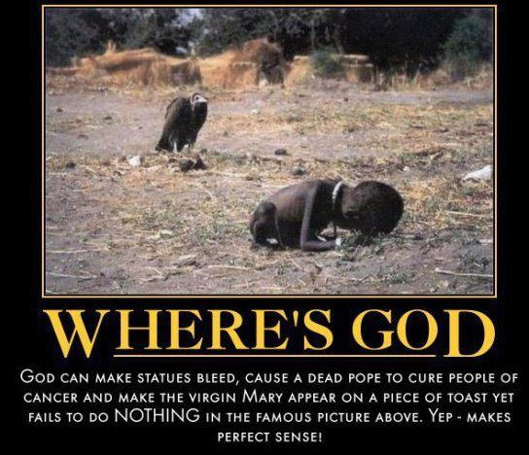
Atheists Commonly Use Suffering Against God
Vulture meat is edible (1 Tim. 4:4)!
What have atheists given this child?
God is not in the Catholic church and has not performed any signs through them (2 Thess. 2:8, 9; 1 Tim. 3:1ff; Matt. 23:9; 1 Pet. 2:9)
Posted by, Yemisi Ilesanmi, freethoughtsblog.com

Slide 17
Atheists Commonly Use Suffering Against God
If evolution and “survival of the fittest” is good, then why is this picture not good to atheists?
If God did cure some people, atheists would still complain that He doesn’t exist because He did not cure all people
Posted by, Yemisi Ilesanmi, freethoughtsblog.com

Slide 18
Atheists Commonly Use Suffering Against God
If their literature is taken seriously, God can never exist if anyone ever suffers and dies
Posted by, Yemisi Ilesanmi, freethoughtsblog.com

Slide 19
Conclusion: If anything bad ever happens, there can be no God!
“Now if we say there is a God and we claim this God is-
Omnipotent- He could have stopped the accident from happening.
Omniscient- He knew that plane was faulty and could even have rectified the fault if he wanted.
Omnipresent- He was present during those agonising [sic] minutes and heard the heart wrenching cries of the people; definitely many would have called out to him in their desperate hour of need while that plane dived to its death. He could have stopped the disaster but chose not to.”
http://freethoughtblogs.com/yemmynisting/2013/05/22/why-thank-god-i-survived-or-god-knows-best-is-a-terrible-thing-to-say-in-the-aftermath-of-a-fatal-disaster/

Slide 20

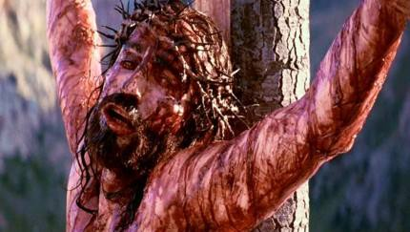
TRUTH
Job never questioned the existence of God
The creature does not have a right to judge the Creator
God allowed His own Son to suffer to reclaim man (Rom. 8:32)
  Sin is more serious than suffering
God never promised to take away human suffering on earth (Jn. 12:8)
  Do not hold Him to something you dream of

Slide 21
TRUTH
God can give “songs in the night”
(Job. 35:10)
Not all suffering is necessarily “evil” as man can grow through it (Rom. 5:3, 4)
Satan is behind much of the suffering in the world (1 Pet. 5:8; Lk. 13:16; Job 1, 2)
Man gave success to Satan’s work by heeding his word and rejecting God’s (Gen. 3:1ff)

Slide 22

Job’s Oath Of Innocence (31)
The allotment of God upon the wicked: destruction (31:1-4)
“If I, if my…then let me, let my” (31:5-40)
  I am willing to suffer if I’ve done wrong
  I have not hid iniquity as Adam (31:33, 34)
  God does not hear me (31:35; 13:3)
  Where is the book of the prosecution (31:35, 36)
Overconfidence to approach God in court even as a prince (31:37; 23:3-7)

Slide 23
These Conversations In Job
Elevated man’s place higher than it deserves
  judgment against the righteous (friends to Job, Job to God)
Lowered God’s place by calling into question His government and power
We can see why God brought so many questions upon Job which culminated in Behemoth and Leviathan!

Slide 24
Will We Prove Satan Wrong?
9 So Satan answered the LORD and said, "Does ______ fear God for nothing?
10 "Have You not made a hedge around him, around his household, and around all that he has on every side? You have blessed the work of his hands, and his possessions have increased in the land.
11 "But now, stretch out Your hand and touch all that he has, and he will surely curse You to Your face!"
Job 1:9-11

